Slide 1
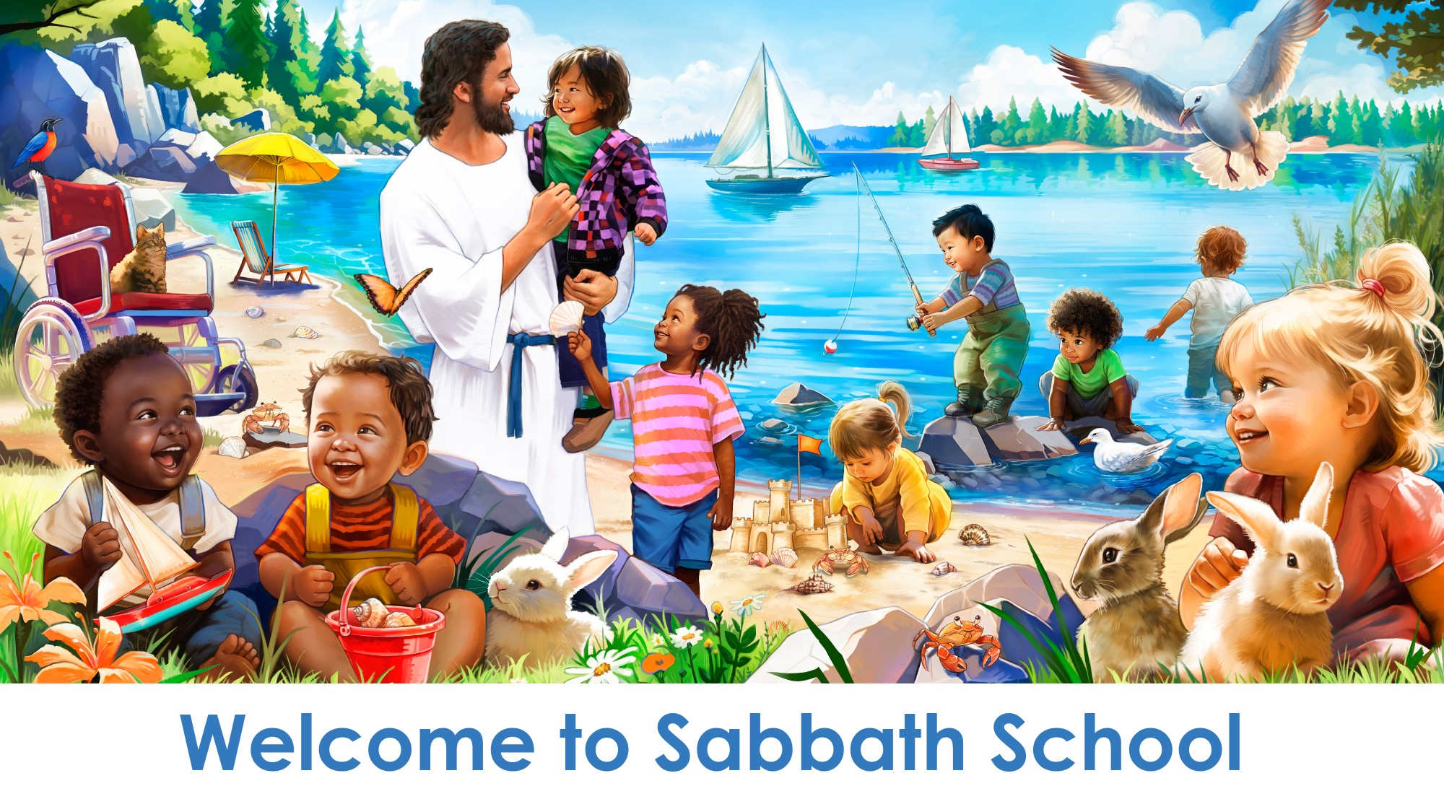
Bem-vindo à Escola Sabatina

Slide 2
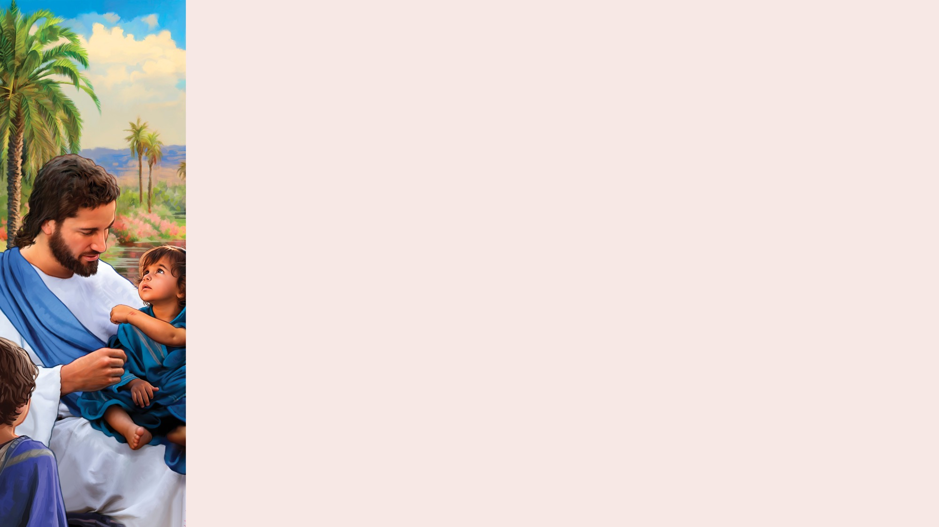

PRAISE TIME
MOMENTO DE LOUVOR
Aperta a minha mão
Aperta a minha mão e diz “Bom dia”.
Aperta a minha mão e diz “Bom dia”.
Aperta a minha mão e diz “Bom dia”.
Feliz estou por estares aqui.
(Repetir)
(Apertem as mãos)
“Shake a Little Hand,” public domain. Adapted words by Noelene Johnsson. From Little Voices Praise Him, #6.

Slide 3
Vê o barco
Olha, olha,
Vê o barco na água.
Olha, olha,
Vê o barco na água.
(Repetir)
(Barco pequeno e recipiente grande de plástico cheio de água)
“See the Boat” by Janet Sage, copyright © 2001 North American Division Corporation of Seventh-day Adventists. From Little Voices Praise Him, #172. Used by permission.

Slide 4
Peixes
Nadam, nadam os peixes na água
Saltam, brincam pelo rio.
Deus fez os peixes que nadam na água
Saltam, brincam pelo mar.
(Peixe de papel num pau ou pequeno peixe de brinquedo)
"Fishy, Fishy" by Janet Sage, copyright © 2001 North American Division Corporation of Seventh-day Adventists. From Little Voices Praise Him, #161. Used by permission.

Slide 5
Seashells
Conchas
Seashells, seashells,
Many pretty seashells,
Rough and shiny ones,
Big and tiny ones,
Jesus made the seashells.
Conchas, conchas,
Tão bonitas conchas.
Belas e valiosas,
Brilhantes e preciosas.
Jesus fez as conchas.
(Shells)
(Conchas marinhas)
“Seashells” by Janet Sage, copyright © 2001 North American Division Corporation of Seventh-day Adventists. From Little Voices Praise Him, #160. Used by permission.
“Seashells” by Janet Sage, copyright © 2001 North American Division Corporation of Seventh-day Adventists. From Little Voices Praise Him, #160. Used by permission.

Slide 6
The Big Blue Ocean
O grande mar azul
The big blue ocean makes me
Think of Jesus’ love,
The big blue ocean, the big blue ocean.
The big blue ocean makes me
Think of Jesus’ love.
Let’s learn of Jesus at the ocean!
O grande mar azul revela o amor de Deus.
O grande mar, o grande mar.
O grande mar azul revela o amor de Deus.
Vem aprender do Seu amor.
(Repetir)
(Blue ribbons)
(Fitas azuis)
“The Big Blue Ocean” by Janet Sage, copyright © 2001 North American Division Corporation of Seventh-day Adventists. From Little Voices Praise Him, #113. Used by permission.
“The Big Blue Ocean” by Janet Sage, copyright © 2001 North American Division Corporation of Seventh-day Adventists. From Little Voices Praise Him, #113. Used by permission.

Slide 7
The Loaves and the Fishes
Os pães e os peixes
One little fish, two little fish,
One, two, three, four,
Five little loaves of bread.
One little fish, two little fish,
One, two, three, four,
Five little loaves of bread.
A um peixe só,
Juntamos mais um,
E 1, 2, 3, 4, 5 pequeninos pães.
(Small piece of bread or a little basket)
(Pequeno pedaço de pão ou um cesto pequeno)
“The Loaves and the Fishes” by Janet Sage, copyright © 2001 North American Division Corporation of Seventh-day Adventists. From Little Voices Praise Him, #55. Used by permission.
“The Loaves and the Fishes” by Janet Sage, copyright © 2001 North American Division Corporation of Seventh-day Adventists. From Little Voices Praise Him, #55. Used by permission.

Slide 8
The Loaves and the Fishes
Os pães e os peixes
One little fish, two little fish,
One, two, three, four,
Five little loaves of bread.
One little fish, two little fish,
One, two, three, four,
Five little loaves of bread.
A um peixe só,
Juntamos mais um,
E 1, 2, 3, 4, 5 pequeninos pães.
(Small piece of bread or a little basket)
(Pequeno pedaço de pão ou um cesto pequeno)
“The Loaves and the Fishes” by Janet Sage, copyright © 2001 North American Division Corporation of Seventh-day Adventists. From Little Voices Praise Him, #55. Used by permission.
“The Loaves and the Fishes” by Janet Sage, copyright © 2001 North American Division Corporation of Seventh-day Adventists. From Little Voices Praise Him, #55. Used by permission.

Slide 9
1 . . . 2 . . . 3, God Loves Me
1, 2, 3, Deus me fez
One, two, three, God loves me.
Arms out wide, come inside.
Full of love, His heart for me.
I’m God’s child, He created me.
1, 2, 3, Deus me fez.
De mim cuidou e me salvou.
Pelos Seus filhos deu o Seu Coração.
Pois amou toda a Criação.
(Repetir)
(Mirrors)
(Espelhos)
“1,2,3, God loves me” by Carolin Schmitz, copyright © 2023 General Conference Corporation® of Seventh-day Adventists.
“1,2,3, God loves me” by Carolin Schmitz, copyright © 2023 General Conference Corporation® of Seventh-day Adventists.

Slide 10
O Sábado
O Sábado é um dia especial.
Eu gosto de ir à igreja cantar e orar.
O Sábado é um dia especial.
Pelo Sábado agradeço.
(Repetir)
(Instrumentos)
“The Sabbath” by Rosie Smith, copyright © 2024 General Conference Corporation® of Seventh-day Adventists.

Slide 11

Dobro os meus joelhos
TEMPO DE ORAÇÃO
Dobro os meus joelhos quando vou orar,
Vou orar, vou orar.
Dobro os meus joelhos quando vou orar
E falo com Jesus.
(Continua no slide seguinte.)

Slide 12
Dobro os meus joelhos
TEMPO DE ORAÇÃO
Fecho os meus olhos quando vou orar,
Vou orar, vou orar.
Fecho os meus olhos quando vou orar
E falo com Jesus.

Slide 13

Eu abro a Bíblia
HORA DA HISTÓRIA BÍBLICA INTERATIVA
INTERACTIVE BIBLE STORY TIME
Eu abro a Bíblia com prazer
E leio do amor de Deus.
Eu abro a Bíblia com prazer
E leio do amor de Deus.
(Repetir)
“I Open My Bible Carefully” by Janet Sage, copyright © 2001 North American Division Corporation of Seventh-day Adventists. From Little Voices Praise Him, #28. Used by permission.

Slide 14

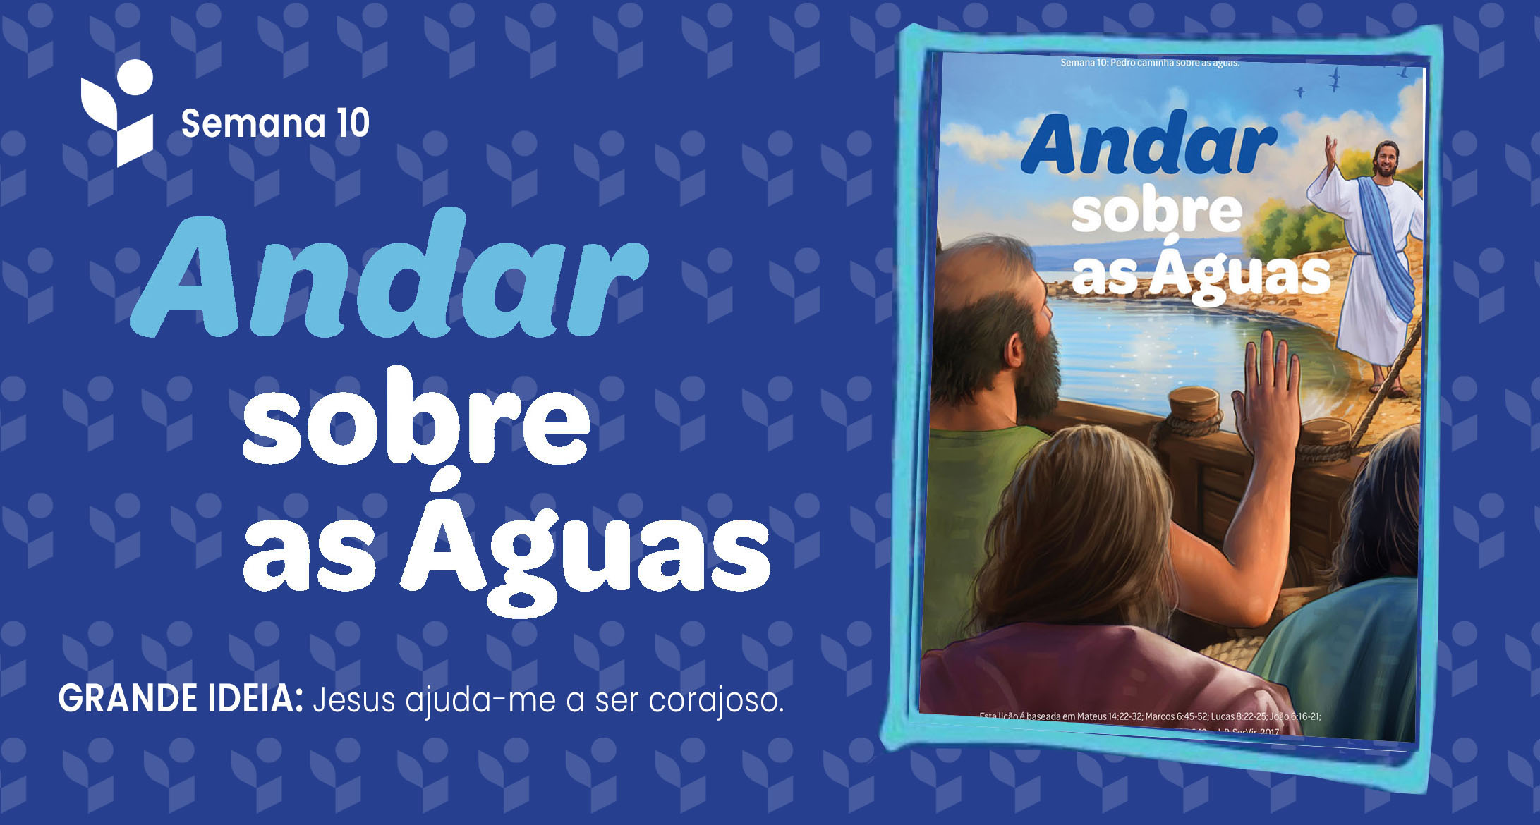

Slide 15
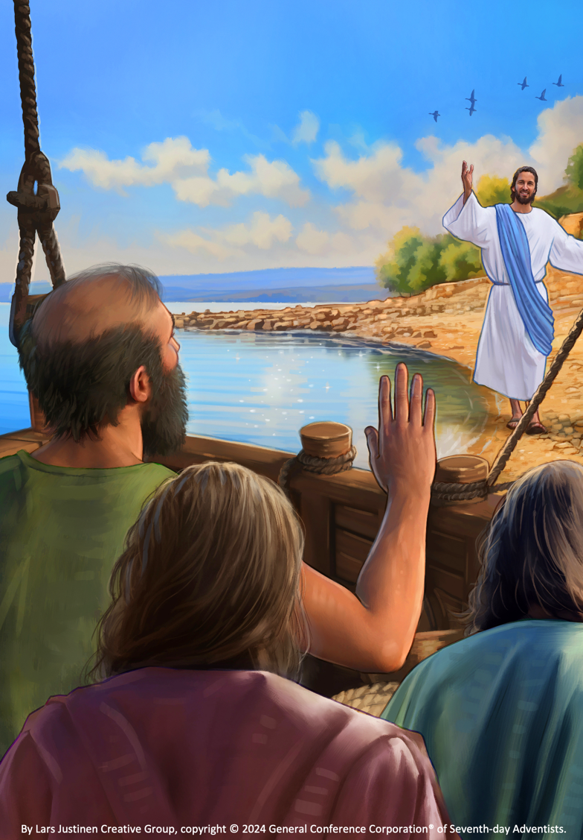

Slide 16
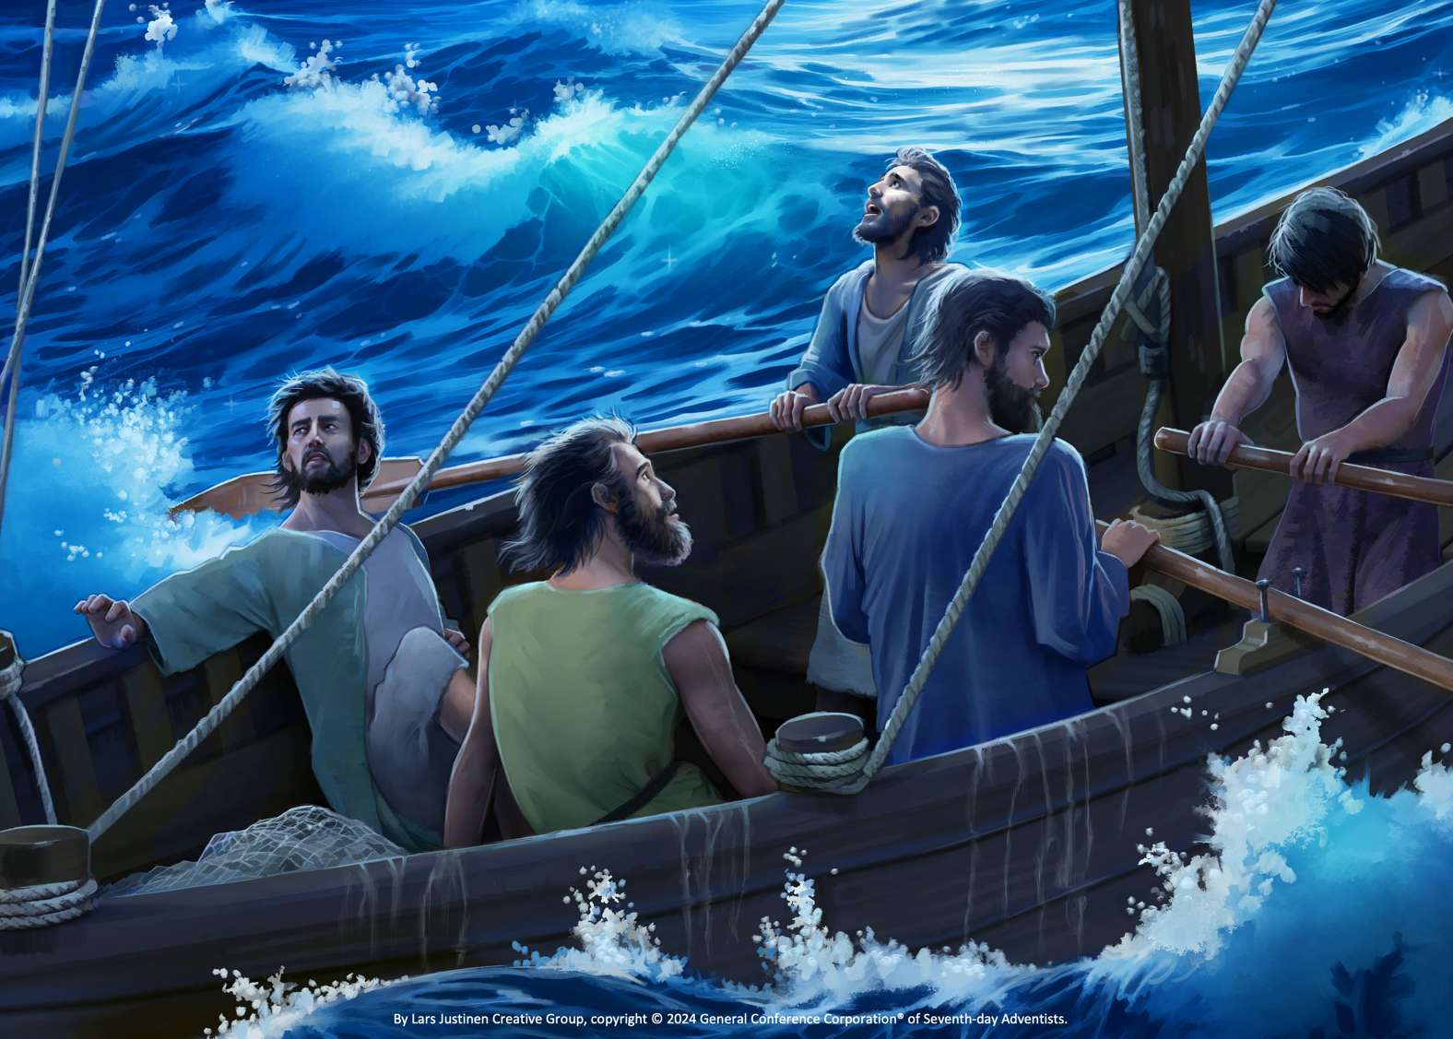

Slide 17
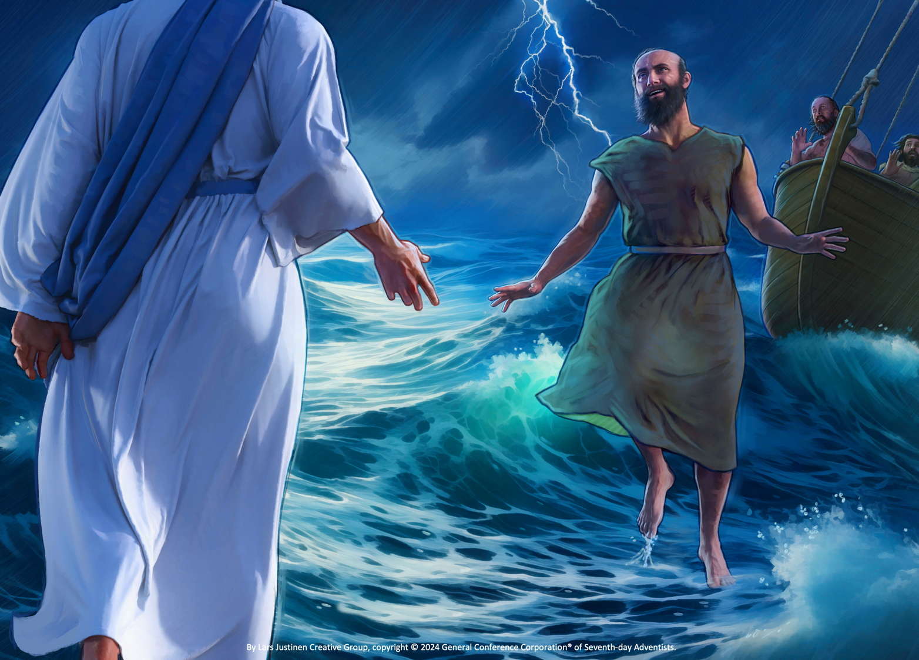

Slide 18
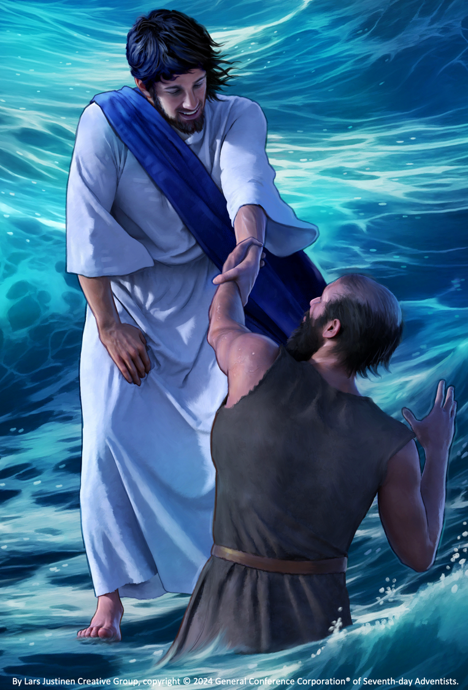

Slide 19

VERSO PARA MEMORIZAR
“Ele tem cuidado
de vós.”
1 PEDRO 5:7
“He Cares for You” by Rosie Smith, copyright © 2024 General Conference Corporation® of Seventh-day Adventists.

Slide 20
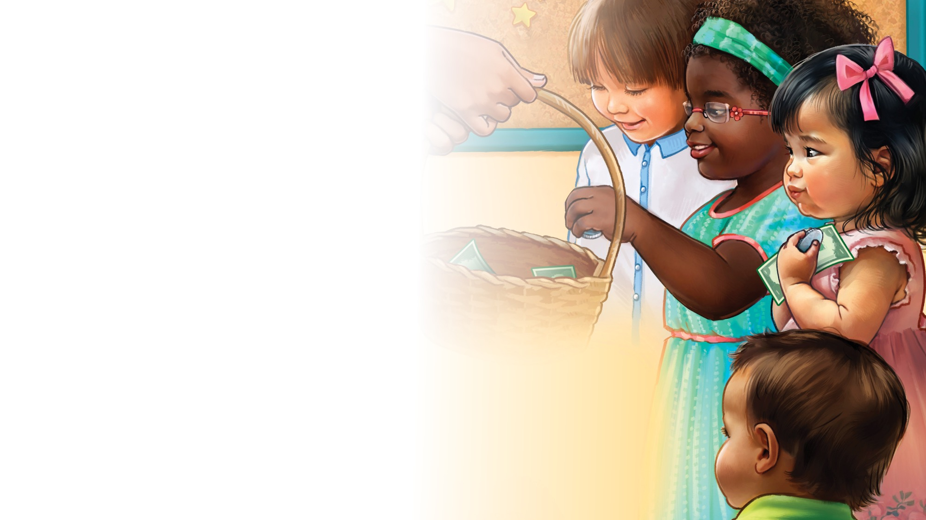
A minha oferta
OFERTA
A Jesus eu dou minha oferta.
Oferta, oferta.
A Jesus eu dou minha oferta.
A Ele dou o meu coração.
“Here Is My Money” by Janet Sage, copyright © 2001 North American Division Corporation of Seventh-day Adventists. From Little Voices Praise Him, #32. Used by permission.

Slide 21

A Caixa da Natureza
O QUE HÁ NA NOSSA CAIXA DA NATUREZA HOJE?
O que está na nossa caixa?
Vou descobrir.
Algo que Jesus fez para mim.
Azul, verde ou vermelho, que será, enfim?
Seja o que for foi feito pra ti.
“Nature box” by Carolin Schmitz, copyright © 2023 General Conference Corporation® of Seventh-day Adventists.

Slide 22
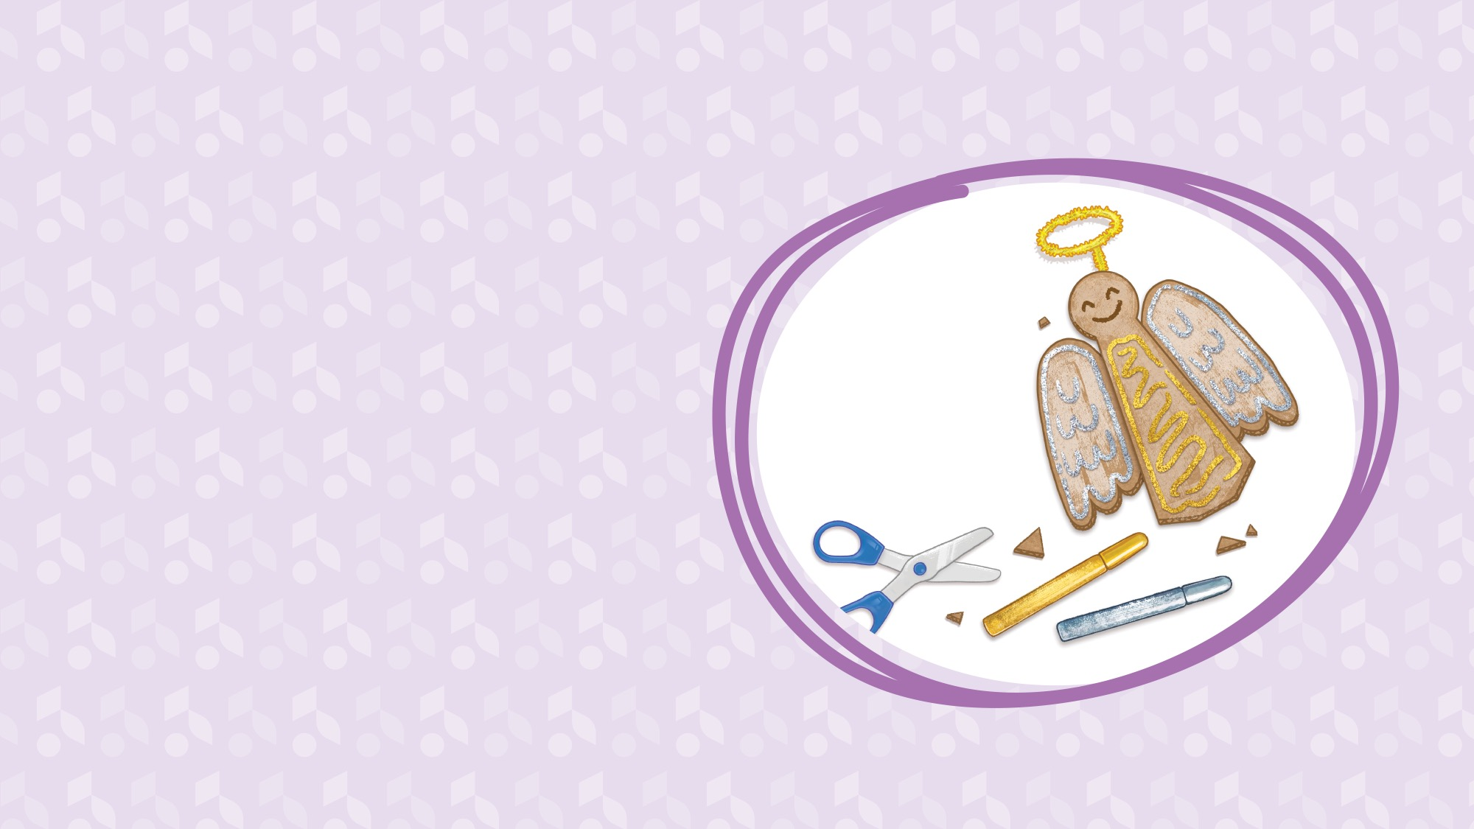
Hora
do
Trabalho Manual

Slide 23
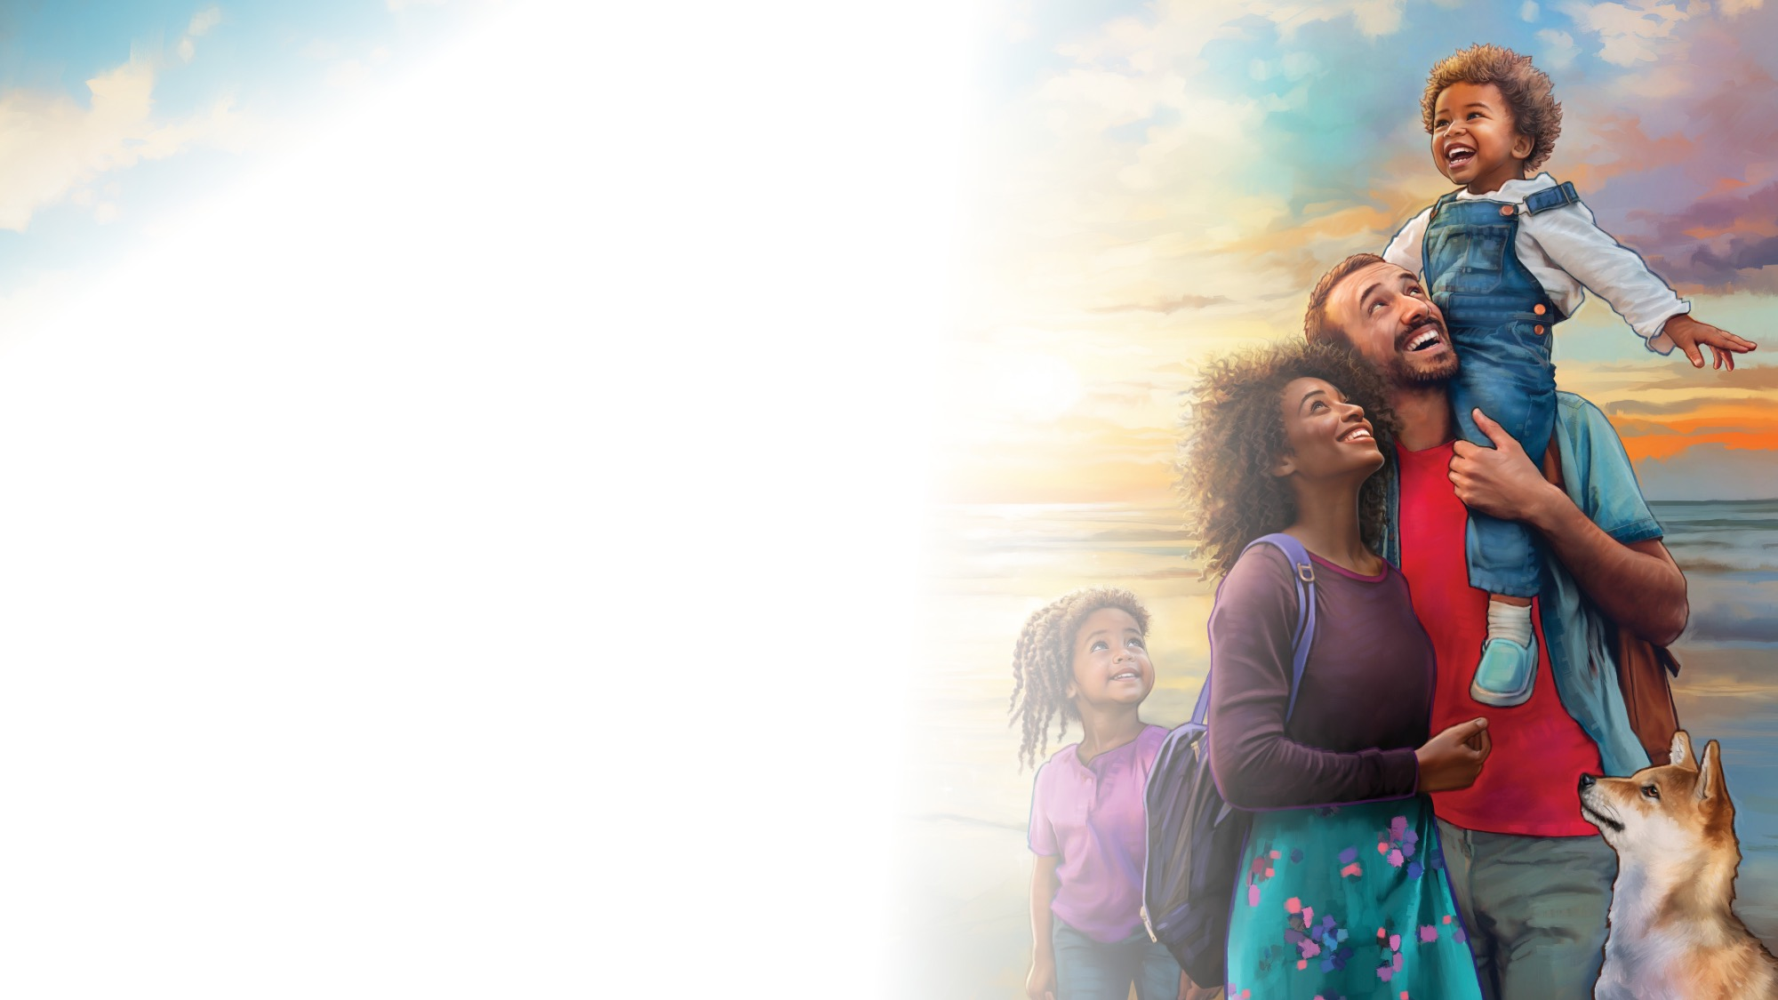
A Escola Sabatina chegou agora ao fim
ADEUS
A Escola Sabatina
chegou agora ao fim.
Adeus, adeus, sejamos sempre bons.
Adeus, adeus, sejamos sempre bons.
(Repetir)
“Sabbath School Is Over,” writer unknown, public domain. From Little Voices Praise Him, #46.

